Slide 1
Internetworking-II
Lecture 19
CT4005NI - Computer Hardware and Software
Architectures

Slide 2
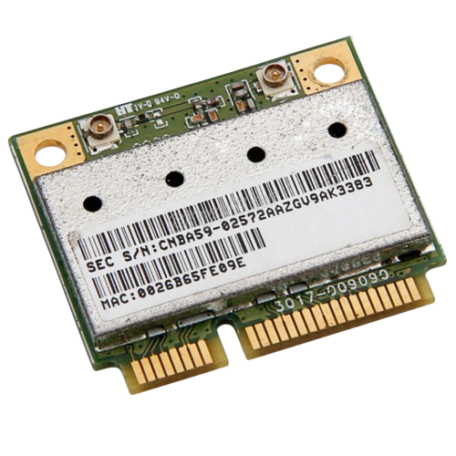
MAC-address
A MAC address (Media Access Control) is a unique identifier assigned to a Network Interface Controller (NIC) for use as a physical address in communications within a network segment.
Notes:
Communication is almost as important to us as our reliance on air, water, food, and shelter.
News events and discoveries are known worldwide in seconds.
Individuals can even connect and play games with friends separated by oceans and continents.

Slide 3
MAC-address
Physical address
Hard-coded
Permanent
48-bit
Represented in 12-Hex
1e:24:33:8d:11:22 or 1e24.338d.1122
Used in datalink layer (Layer 2)
Notes:
Communication is almost as important to us as our reliance on air, water, food, and shelter.
News events and discoveries are known worldwide in seconds.
Individuals can even connect and play games with friends separated by oceans and continents.

Slide 4
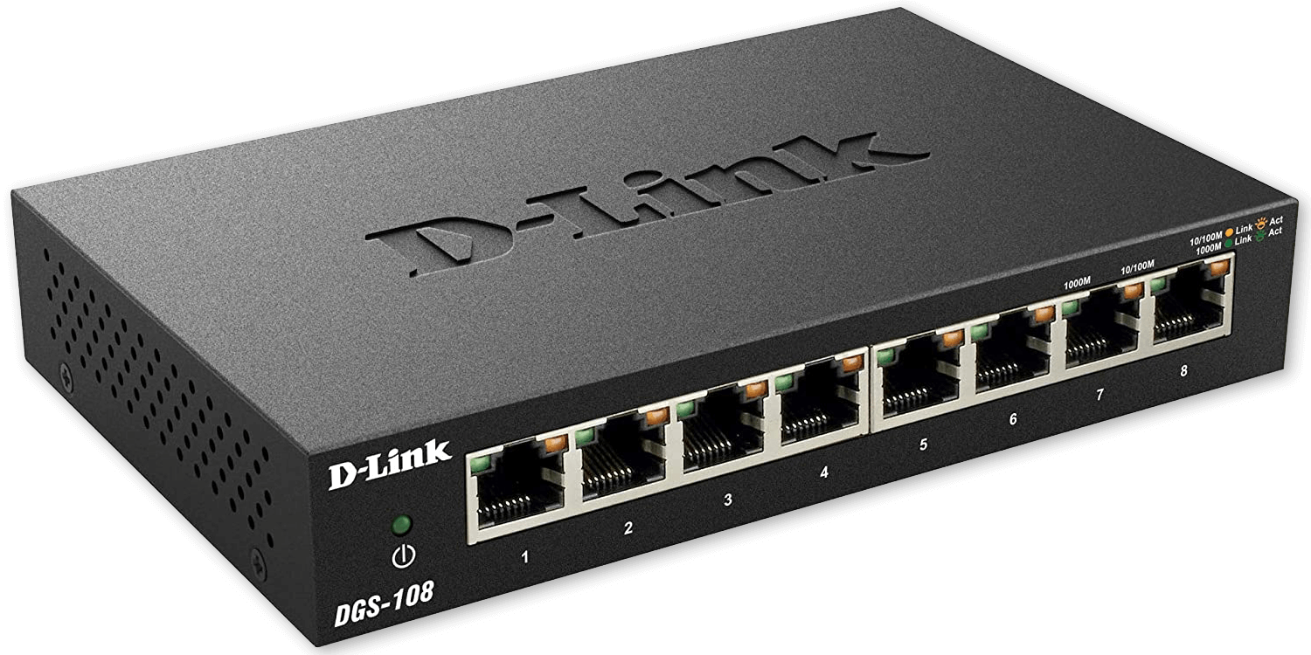
Switch
A switch is a networking device that is used to connect devices within the same subnet using MAC-address.
It is a Layer 2 (Datalink Layer Device)
It breaks down collision domain as each port of switch is a different collision domain.
Notes:
Communication is almost as important to us as our reliance on air, water, food, and shelter.
News events and discoveries are known worldwide in seconds.
Individuals can even connect and play games with friends separated by oceans and continents.

Slide 5
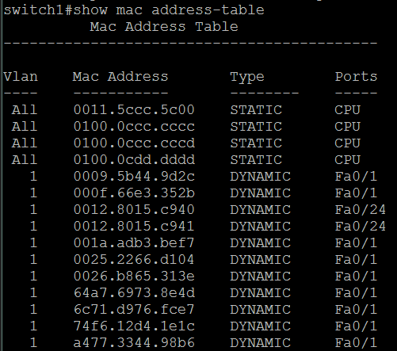
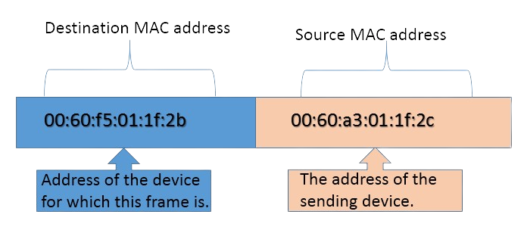
Switch
Switch looks for the Layer 2 header to find the destination .
It uses Mac-address table to find to which port the mac-address corresponds to and sends frame to that port.
Notes:
Communication is almost as important to us as our reliance on air, water, food, and shelter.
News events and discoveries are known worldwide in seconds.
Individuals can even connect and play games with friends separated by oceans and continents.

Slide 6
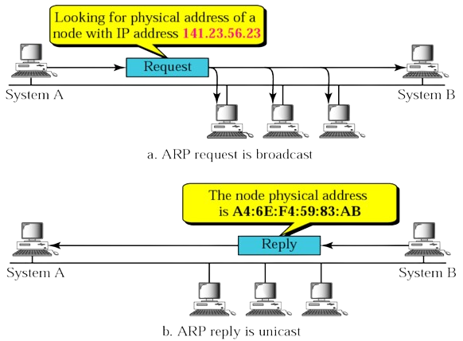
ARP (Address Resolution Protocol)
ARP protocol is used to find the mac-address of an IP address.
It uses broadcast to send ARP
request. For broadcasting the
destination mac-address set to
FFFF.FFFF.FFFF
And gets reply in an unicast
Notes:
Communication is almost as important to us as our reliance on air, water, food, and shelter.
News events and discoveries are known worldwide in seconds.
Individuals can even connect and play games with friends separated by oceans and continents.

Slide 7
Broadcast Domain
A broadcast domain in a network refers to the area within a computer network where broadcast packets, such as those sent using the Address Resolution Protocol (ARP) are received by all devices.
Broadcast domain is received in one port of the router but is not sent to other ports of the router. Hence, router breaks the broadcast domain.
Notes:
Communication is almost as important to us as our reliance on air, water, food, and shelter.
News events and discoveries are known worldwide in seconds.
Individuals can even connect and play games with friends separated by oceans and continents.

Slide 8
Why Network Segmentation is required?
With traffic growth, a LAN’s traffic congestion has reached epic proportions.
Thus we use Network Segmentation.
Using devices such as routers, switches and bridges.
List of things which causes a LAN traffic congestion:
Too many hosts in a broadcast and collision domain.
Broadcast storms.
Low bandwidth.
Adding Hubs for connectivity.

Slide 9
Router
Routers are used to create Internetworks as they route packets of data from one network to the another.
Routers by default break up a broadcast domain.
Routers are also used to provide connections to the WAN services (through the use of serial interfaces).

Slide 10
Functions of Router
Four router functions in a computer network can be listed as:
Internetwork communication.
Path finding
Best Path Selection
Packet filtering.

Slide 11
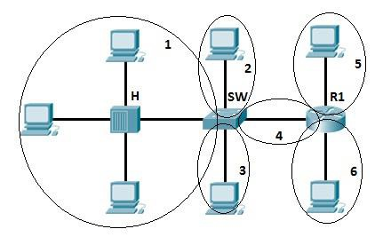
Collision and broadcast domains
Collision domain represents a part of a network where packet collision can occur.
A collision occurs when two devices send a packet at the same time on a shared network segment.

Slide 12
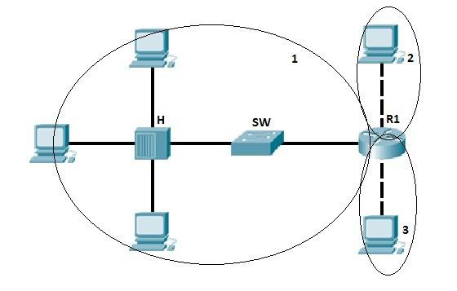
Collision and broadcast domains
A broadcast domain is a domain in which a broadcast is forwarded.
A broadcast domain contains all the devices that can reach other at data link layer by using broadcast.

Slide 13
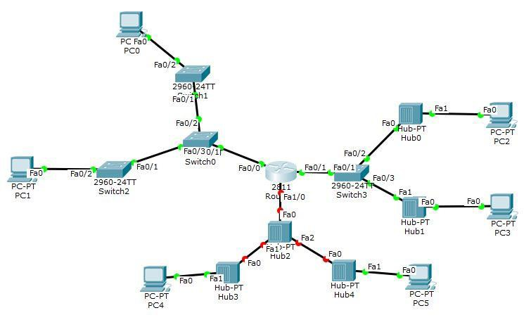
Collision and broadcast domains
How many collision domains and broadcast domains are there in the following topology?

Slide 14
Answer:
9 collision domains and 3 broadcast domains are there in the following topology.

Slide 15
End of Lecture 19

